Slide 1

Ensemble Deep Learning Framework for Code Smell Detection
Prof. Salman Abdul Moiz
Vamshi Bachu,21mcme03
Supervisor : Prof. Salman Abdul Moiz
School of Computer and Information Sciences
University Of Hyderabad

Slide 2
Table of contents
TABLE OF CONTENTS
Introduction
Types of Smells
Motivation and Existing Approaches
Machine Learning–Based Baseline Experiments
Machine learning Results comparison
The Gap and The solution
Ensemble results
Top performers
Precision and recall trade-off
Key insights
Where are we lagging ?
Conclusion
future work

Slide 3
Introduction
A software smell indicates suboptimal design, hindering understanding and increasing the risk of changes and faults.
Identifying all code issues at an early stage of the software development process helps to improve software quality.
Notes:
A code smell is like a warning sign in the code—something that may not be an actual bug, but makes the code harder to read, maintain, or improve.
For example, a code smell can be a really long method, a class doing too many things, or confusing naming.

Slide 4
Types of Smells
Long Method : Method which is too long and does multiple tasks at once
Data Class : Class that only contains variables and getters/setters, but does not contain any work on it.
Feature Envy : A method that relies more on the data or functions of an external class than those of its own class
God Class : A class that does too many things making it difficult to maintain or update
Notes:
Long Method : Method which is too long and does multiple tasks at once
Data Class : Class that only contains variables and getters/setters, but does not contain any work on it.
Feature Envy : When a method uses another class data too much than its own.
God Class : A class that does too many things making it difficult to maintain or update

Slide 5
Motivation and Existing Approaches
Code smells indicate design and quality issues that make software harder to maintain and scale.
Existing approaches :
Machine learning–based approaches that use software metrics as features to detect code smells.
Deep learning–based approaches that uses code embeddings to identify code smells.
Notes:
A code smell is like a warning sign in the code—something that may not be an actual bug, but makes the code harder to read, maintain, or improve.
For example, a code smell can be a really long method, a class doing too many things, or confusing naming.

Slide 6
Machine Learning–Based Baseline Experiments
Extracted software metrics as features to detect code smells.Performed data cleaning and used k-fold cross-validation to maintain class balance across folds.
Tried out multiple machine learning models like Naive Bayes, Nearest Neighbor, Random Forest, Logistic Regression, Classification and Regression Tree, Support Vector Machine, Back Propagation Neural Networks. Reported simple, understandable metrics like Precision, Recall,F1-Score and MCC
Notes:
A code smell is like a warning sign in the code—something that may not be an actual bug, but makes the code harder to read, maintain, or improve.
For example, a code smell can be a really long method, a class doing too many things, or confusing naming.

Slide 7
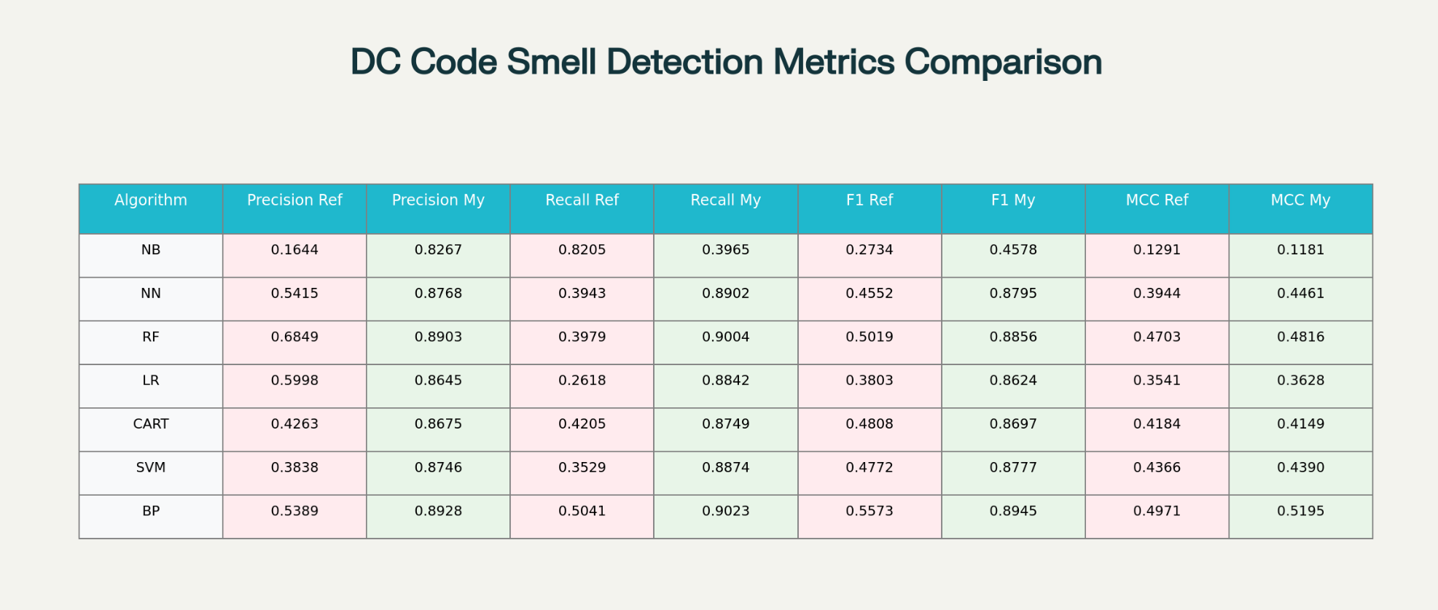
Machine learning Results comparison

Slide 8
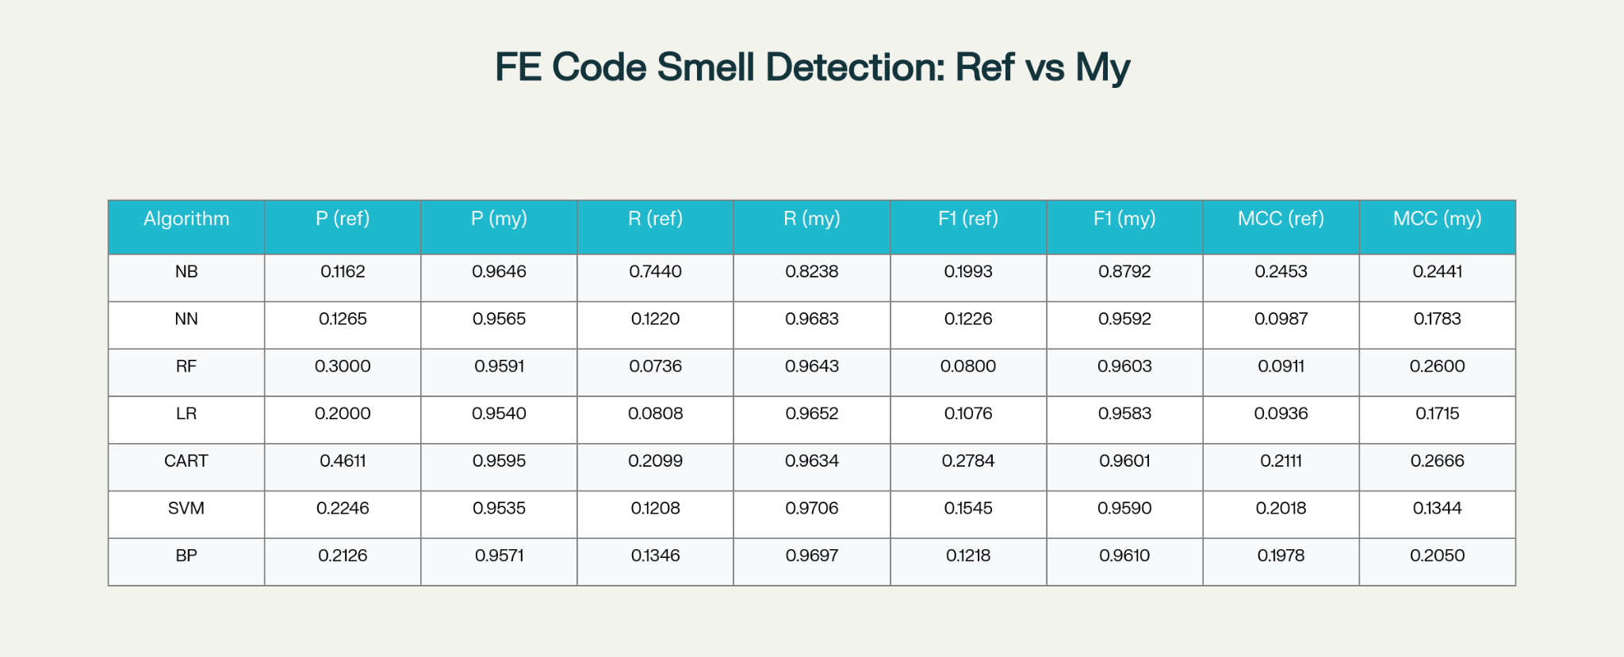
Machine learning Results comparison

Slide 9
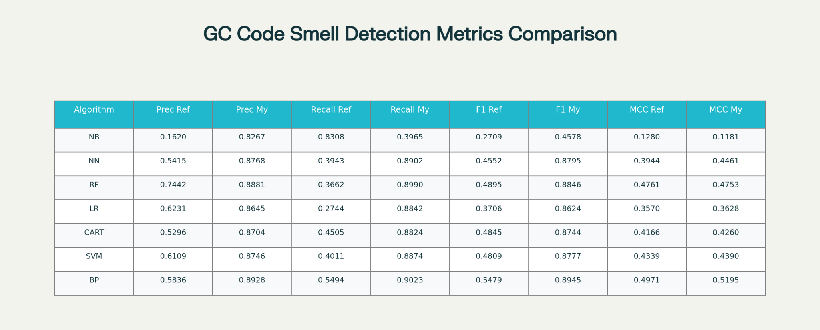
Machine learning Results comparison

Slide 10
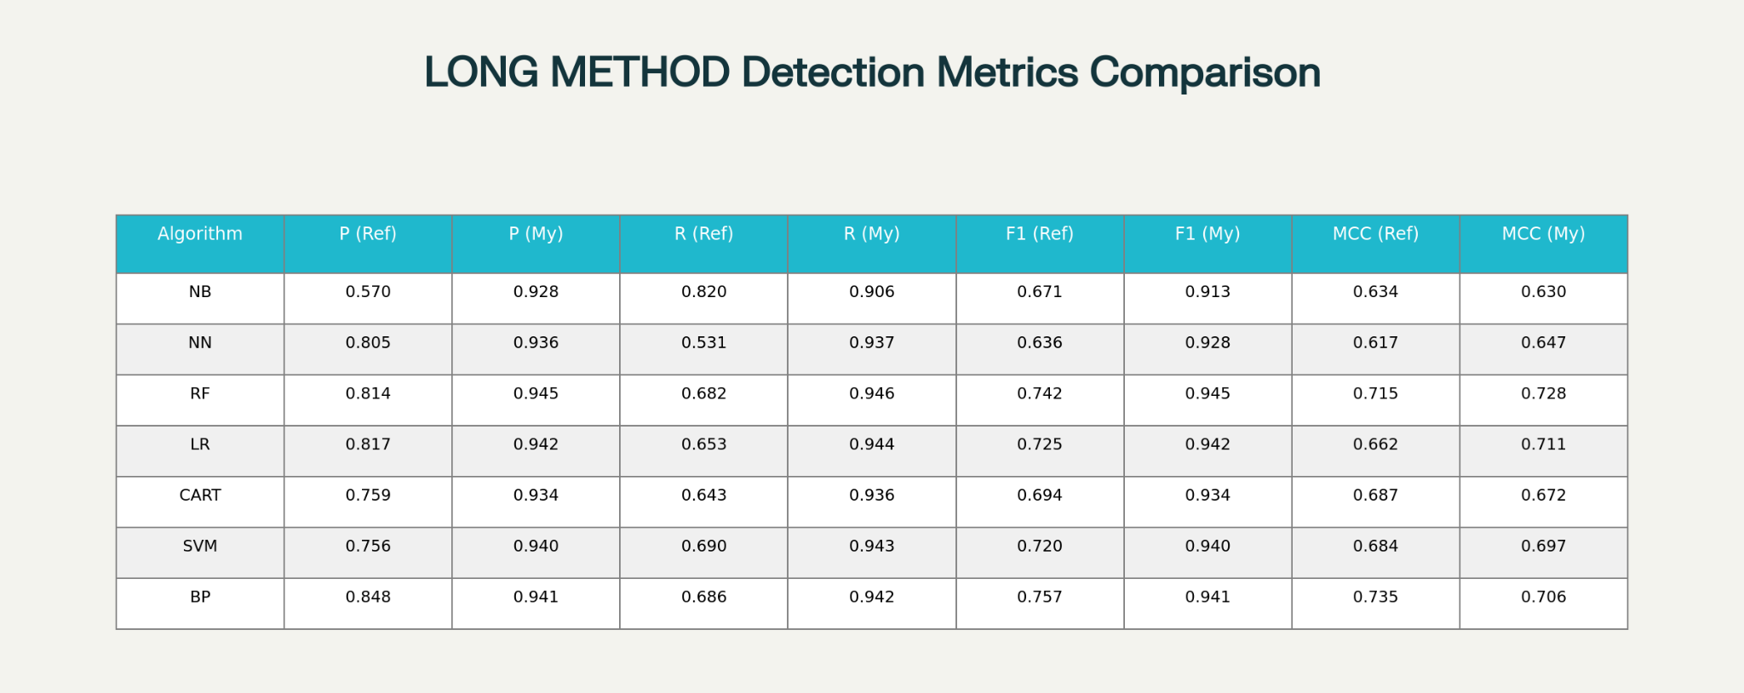
Machine learning Results comparison

Slide 11
The Gap and The solution
Machine learning methods misses semantic information of the code.
Deep learning methiod misses structural indicators for detection
Solution : EnseSmells
A MultiModal Ensemble Framework that combines Semantic Code representations with Structural Software embeddings for code smell detection.
Notes:
A code smell is like a warning sign in the code—something that may not be an actual bug, but makes the code harder to read, maintain, or improve.
For example, a code smell can be a really long method, a class doing too many things, or confusing naming.

Slide 12
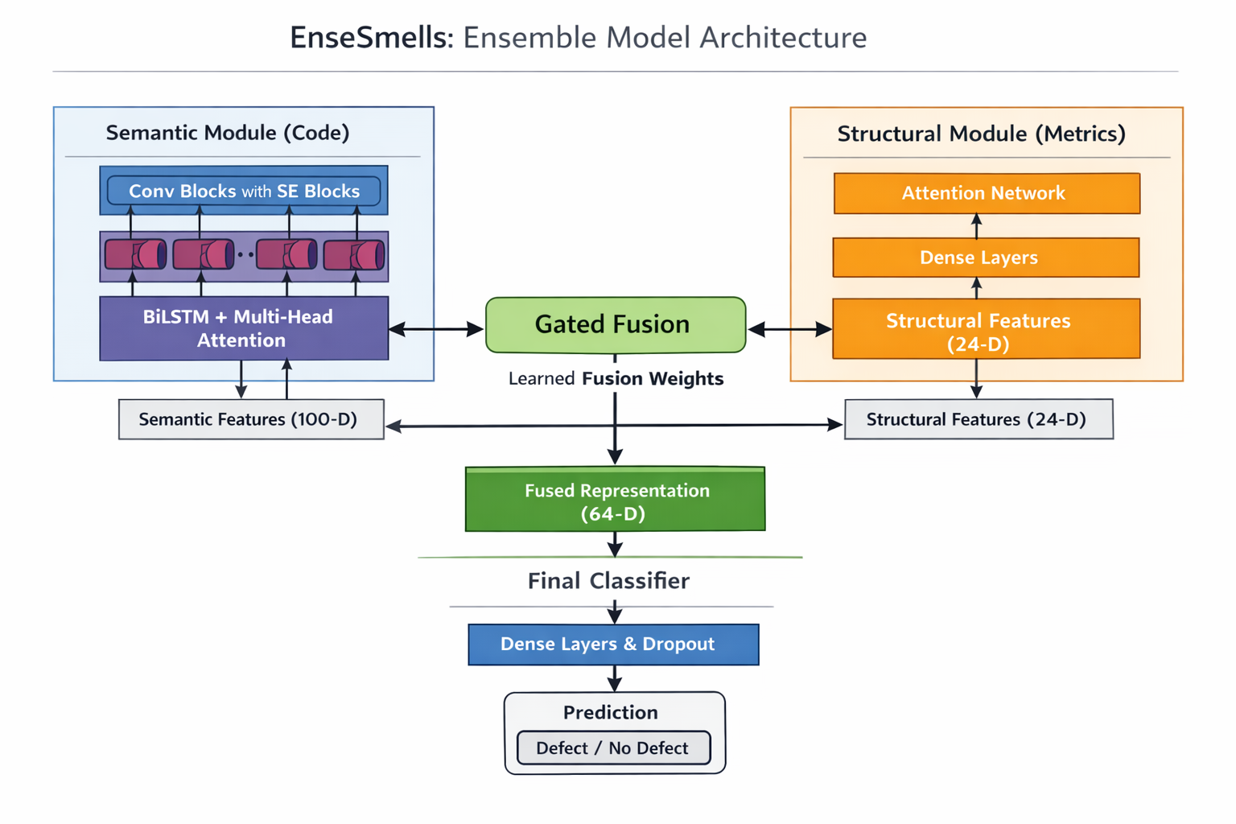

Slide 13
Ensemble results
Long Method
Model | Source | Precision | P Diff | Recall | R Diff | F1 | F1 Diff | MCC | MCC Diff
CuBERT | Paper | 0.8482 |  | 0.7391 |  | 0.7877 |  | 0.7616
 | Mine | 0.6880 | -0.1602 | 0.8695 | +0.1304 | 0.7659 | -0.0218 | 0.7392 | -0.0224
CodeBERT | Paper | 0.7938 |  | 0.7824 |  | 0.7857 |  | 0.7611
 | Mine | 0.7448 | -0.0490 | 0.8250 | +0.0426 | 0.7808 | -0.0049 | 0.7550 | -0.0061
code2vec | Paper | 0.7526 |  | 0.8242 |  | 0.7841 |  | 0.7618
 | Mine | 0.7402 | -0.0124 | 0.8811 | +0.0569 | 0.8021 | +0.0180 | 0.7808 | +0.0190
TokenIndexing | Paper | 0.8215 |  | 0.7873 |  | 0.8016 |  | 0.7780
 | Mine | 0.7473 | -0.0742 | 0.8816 | +0.0943 | 0.8055 | +0.0039 | 0.7854 | +0.0074

Slide 14
Ensemble results
Data Class
Model | Source | Precision | P Diff | Recall | R Diff | F1 | F1 Diff | MCC | MCC Diff
CuBERT | Paper | 0.8027 |  | 0.4567 |  | 0.5772 |  | 0.5238
 | Mine | 0.4672 | -0.3355 | 0.8100 | +0.3533 | 0.5909 | +0.0137 | 0.5390 | +0.0152
CodeBERT | Paper | 0.7447 |  | 0.5390 |  | 0.6199 |  | 0.5648
 | Mine | 0.6036 | -0.1411 | 0.7077 | +0.1687 | 0.6481 | +0.0282 | 0.5935 | +0.0287
code2vec | Paper | 0.8123 |  | 0.5314 |  | 0.6393 |  | 0.5907
 | Mine | 0.6010 | -0.2113 | 0.5978 | +0.0664 | 0.5970 | -0.0423 | 0.5363 | -0.0544
TokenIndexing | Paper | 0.7340 |  | 0.5427 |  | 0.6203 |  | 0.5638
 | Mine | 0.6230 | -0.1110 | 0.6356 | +0.0929 | 0.6257 | +0.0054 | 0.5694 | +0.0056

Slide 15
Ensemble results
God Class
Model | Source | Precision | P Diff | Recall | R Diff | F1 | F1 Diff | MCC | MCC Diff
CuBERT | Paper | 0.5565 |  | 0.5105 |  | 0.5153 |  | 0.4675
 | Mine | 0.4220 | -0.1345 | 0.6872 | +0.1767 | 0.5177 | +0.0024 | 0.4657 | -0.0018
CodeBERT | Paper | 0.5993 |  | 0.5607 |  | 0.5764 |  | 0.5241
 | Mine | 0.4718 | -0.1275 | 0.7140 | +0.1533 | 0.5671 | -0.0093 | 0.5161 | -0.0080
code2vec | Paper | 0.5947 |  | 0.5724 |  | 0.5729 |  | 0.5288
 | Mine | 0.4454 | -0.1493 | 0.7797 | +0.2073 | 0.5654 | -0.0075 | 0.5227 | -0.0061
TokenIndexing | Paper | 0.6962 |  | 0.5077 |  | 0.5801 |  | 0.5318
 | Mine | 0.4233 | -0.2729 | 0.8297 | +0.3220 | 0.5544 | -0.0257 | 0.5215 | -0.0103

Slide 16
Ensemble results
Feature Envy
Model | Source | Precision | P Diff | Recall | R Diff | F1 | F1 Diff | MCC | MCC Diff
CuBERT | Paper | 0.5215 |  | 0.3393 |  | 0.4025 |  | 0.3868
 | Mine | 0.2026 | -0.3189 | 0.7145 | +0.3752 | 0.3120 | -0.0905 | 0.3449 | -0.0419
CodeBERT | Paper | 0.5128 |  | 0.2718 |  | 0.3527 |  | 0.3449
 | Mine | 0.1649 | -0.3479 | 0.6873 | +0.4155 | 0.2653 | -0.0874 | 0.2993 | -0.0456
code2vec | Paper | 0.4423 |  | 0.3727 |  | 0.3538 |  | 0.3568
 | Mine | 0.2455 | -0.1968 | 0.5289 | +0.1562 | 0.3208 | -0.0330 | 0.3206 | -0.0362
TokenIndexing | Paper | 0.4821 |  | 0.3554 |  | 0.3982 |  | 0.3849
 | Mine | 0.2942 | -0.1879 | 0.5673 | +0.2119 | 0.3063 | -0.0919 | 0.3350 | -0.0499

Slide 17
Top performers
Code Smell | Best Configuration | Top F1 Score (vs. Baseline)
Long Method | Code2vec + Multi-Head Attention | 0.8176 (+4.3%)
Data Class | TokenIndexing + Simple Attention | 0.6410 (+3.3%)
God Class | CodeBERT + Simple Attention | 0.5881 (+2.0%)
Feature Envy | TokenIndexing + Multi-Head (Best Attempt) | 0.3569 (-10.4% Gap)

Slide 18
Precision and recall trade-off
Base Paper Results:
High Precision, Lower Recall.
They often miss potential smells (lower recall) but are typically accurate when a smell is flagged (high precision).
Our Results:
Lower Precision, High Recall.
We are more successful at detecting a broader range of potential smells than the paper (high recall).
However, we are less accurate in correctly identifying the true smells compared to the paper (lower precision).

Slide 19
Key insights
Smell-wise Interpretation
LongMethod → ~87% Semantic, ~13% Structural.
GodClass → ~66% Semantic, ~34% Structural (high variance).
FeatureEnvy → ~18% Semantic, ~82% Structural.
DataClass → ~12% Semantic, ~88% Structural.

Slide 20
Where are we lagging ?
Feature Envy is the only category, where we are getting consistently lower results
Current our architecture is based on self attention where code attends to present class only, but feature envy smell depends on external dependencies
Implementing cross attention may help because it attends to other classes but other smells(LM,DC,GC) gets external context that may degrade our results.

Slide 21
Conclusion
Proposed EnseSmells, a multimodal ensemble model combining code embeddings and software metrics.
The gated fusion learns how to balance both sources automatically.
Achieves better performance than single-input methods and shows that different smells need different information.

Slide 22
future work
Add explainability using attention weights.
Support inter-file / inter-class smells (especially FeatureEnvy).
Test on more smells and larger datasets.
Explore graph-based code representations.

Slide 23
References
References
[1] A. Ho et al., “EnseSmells: Deep ensemble and programming language models for automated code smells detection,” Journal of Systems and Software, 2025.

Slide 24
Thank you

